Slide 1
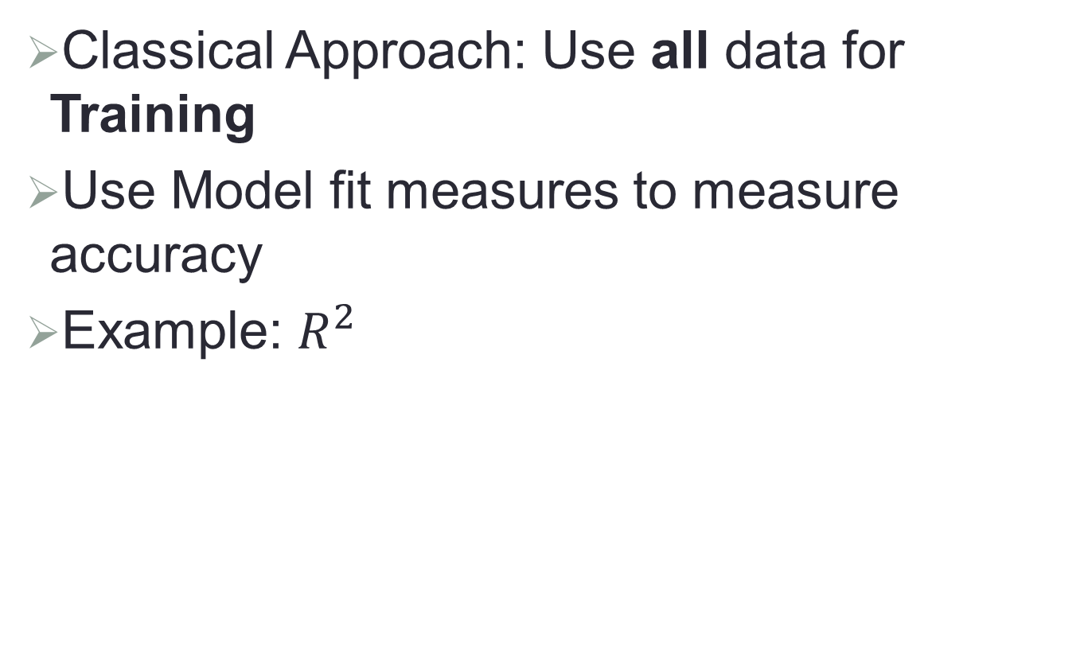
Training vs. Test Data
Classical Approach: Use all data for Training
Use Model fit measures to measure accuracy
Example: $R^{2}$
Notes:
(CLICK)Those who use classical approach like linear regression will use all of the available data for building the model. (CLICK)They will use some measures to check how well the model fits the entire data. (CLICK)For example, R-square is such a measure. A high R-square value indicates that model accurately fits the data. We will discuss more details about R-square in a different video.

Slide 2
Training vs. Test Data
Modern Approach:
Training part is used to build model
Validation data is used to access the model performance
Example: MSE (Training MSE; Test MSE)
Training Data
Data
Test (Validation) Data
Notes:
(CLICK) In modern day approach, (CLICK) available data is divided into (CLICK) training and test data sets. (CLICK)Then, only the training part is used to build different models that compete against each other to be chosen as the final model. (CLICK) We choose the model that gives the lowest error rate when applied to the validation data. (CLICK) Error measures like Mean Square Error would be calculated on the training side as well as test side of the data. Whichever model ends up with the least test error will be declared as the winner.

